Slide 1
PARTICIPLE
A word formed from a verb eg. Going,gone
And used as an adjective eg. Working woman
( you are in a zoo and there are two ducks one is eating n other is swimming. And you say look at that eating duck or swimming duck here eat and swim are not verbs they are acting as adjectives.
The car which I bought yesterday, broke down.

Slide 2
particles as adjectives
Particles, also known as "phrasal adjectives" or "adjectival particles," are groups of words that act together as adjectives to modify nouns or pronouns. They are composed of an adjective followed by a particle, often a preposition or an adverb, which together create a new meaning. These combinations provide additional information about the noun they modify, such as the origin, condition, location, or purpose.
Example:
Hardworking students always succeed.
"Hardworking" is the particle that modifies the noun "students," indicating that they work diligently.
The broken glass needs to be cleaned up.
"Broken" is the particle that describes the state of the noun "glass."

Slide 3
Some participles (like 'bored' or 'boring') can be used as adjectives. These are used in a slightly different way from normal adjectives. We usually use the past participle (ending in -ed) to talk about how someone feels:
I was really bored during the flight (NOT: I was really boring during the flight).
She's interested in history (NOT: She's really interesting in history).
John's frightened of spiders (NOT: John's frightening of spiders).

Slide 4
These participle adjectives make their comparative by using 'more' (not -er) and their superlative by using 'most' (not -est):
I was more frightened of dogs than spiders when I was a child.
That book is more boring than this one.
I think Dr Smith's lesson was more interesting than Dr Brown's.
For 24 hours on the flight to Australia, I was the most bored I've ever been.
I think this is the most interesting talk we've heard today.
It was the most frightening film that he'd ever seen.

Slide 5
RELATIVE PRONOUNS
WHO
WHOM (object)
WHICH
WHOSE
THAT
They introduce relative clauses.
A relative clause tells us which person or thing the speaker means/ refers to.

Slide 6
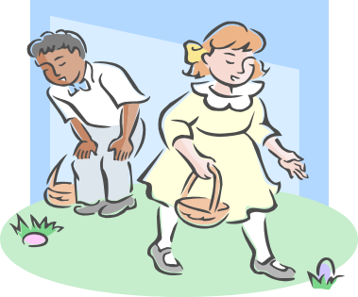
Who / that: refer to people
Those people live next door. They have 16 children.
The people who /that live next door have 16 children.

Slide 7
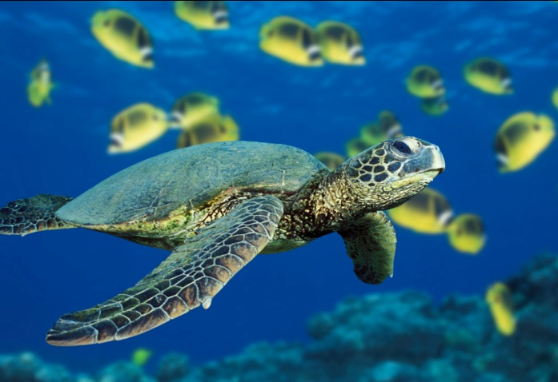
Which / that: refer to things
A turtle is an animal. It lives in the sea.
A turtle is an animal which / that lives in the sea.

Slide 8
SUBJECT OF RELATIVE CLAUSE
I know a man. He is a lawyer.
I know a man who / that is a lawyer.
A dog ran away. A dog is mine.
The dog which /that ran away is mine.
CAN NEVER BE OMITTED

Slide 9
OBJECT OF RELATIVE CLAUSE
I spoke to a man. I had met him before.
I spoke to a man (whom/who/that/--) I had met before.
That’s the book. I read it last summer.
That’s the book (which/that/ --) I read last summer.
CAN BE OMITTED IN DEFINING RELATIVE CLAUSES.

Slide 10
WHOSE=possessive adjectives with people, objects and animals
That’s the woman- her house caught fire yesterday.
That’s the woman whose house caught fire yesterday.
That’s the house- its entrance is guarded.
That’s the house whose entrance is guarded.
CAN NEVER BE OMITTED

Slide 11
PREPOSITIONS(usually avoid prep. Before relative pronouns)
That’s the car for which I paid $2,000. ( more formal)
That’s the car which / that I paid $2,000 for. (more usual)
That’s the car I paid $2,000 for. (everyday English)

Slide 12
RELATIVE CLAUSES
DEFINING RELATIVE CLAUSES
WHO
WHOM
WHICH
THAT
WHEN, WHERE
NON-DEFINING RELATIVE CLAUSES
WHO
WHOM
WHICH
WHEN, WHERE

Slide 13
DEFINING RELATIVE CLAUSES
Necessary information
Essential to the meaning of the main sentence
Relative pronouns can be omitted when they are the object of the relative clause
The relative clause is not put in commas

Slide 14
. People are fined. (Which people?)
People who /that park illegally are fined.
(Which people? Those who park illegally)
. The film was boring (Which film?)
The film (which/ that) I watched yesterday was boring.
(Which film? The one I watched yesterday)

Slide 15
NON-DEFINING RELATIVE CLAUSES
They give extra information
Not essential to the meaning of the sentence
RELATIVE PRONOUNS CANNOT BE OMITTED
THAT CANNOT BE USED
THE RELATIVE CLAUSE IS PUT IN COMMAS

Slide 16
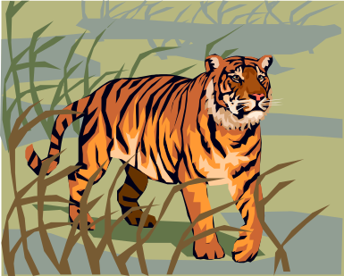
. The Jeffersons live next door.
The Jeffersons, who own a Jaguar, live next door.
My cat is called Monty.
My cat, which I found on the street, is called Monty.

Slide 17

RELATIVE ADVERBS
WHERE
WHEN
WHY: THE REASON WHY
I didn’t get a pay rise – that was the reason why I left.
I didn’t get a pay rise – that was the reason (that) I left.

Slide 18
DEFINING RELATIVE CLAUSES
WHERE: refers to place, after nouns like: place, house, street, town and country.
The street where we used to play is very busy now.
The street (which /that) we used to play in is very busy now

Slide 19
WHEN: refers to time, after nouns like: time, period, moment, day…
I’ll never forget the day when I first met him.
I’ll never forget the day (that) I first met him.

Slide 20
NON-DEFINING
WHERE: always after a named place.
WHEN: always after a named time.
I stopped in Dallas, where my sister lives.
Come back at 3:30, when I won’t be busy.

